Slide 1
Deploy reports
Deploy reports

Slide 2
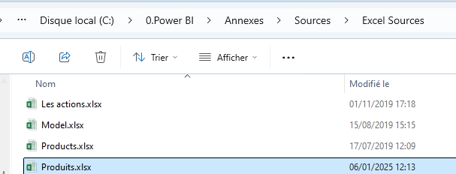
Deploy reports
Note: This workshop requires a Power BI account
Note: This exercise uses Sample1.pbix from Products.xlsx at the Excel Sources folder level

Slide 3
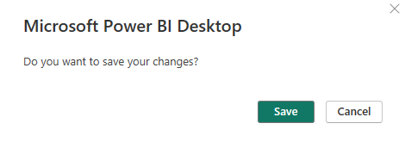
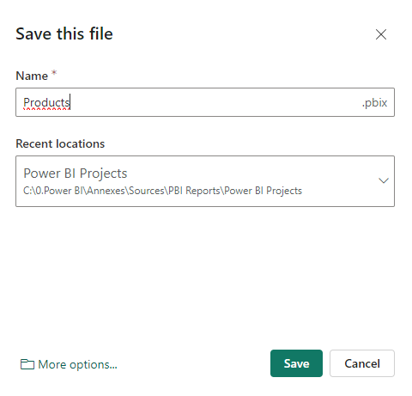
Deploy reports
Save the report and publish it to the workspace of your choice by clicking the Select button.

Slide 4
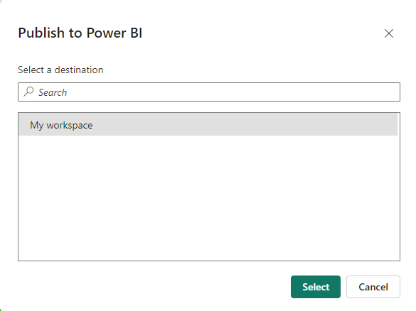
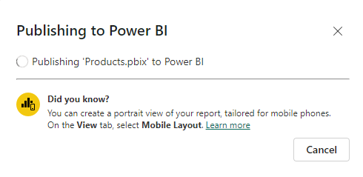
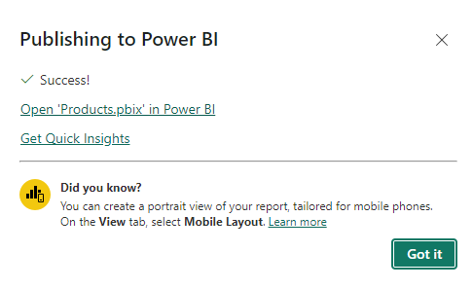
Deploy reports
Select the workspace where the report will be published Ex: My workspace
2
1
3

Slide 5
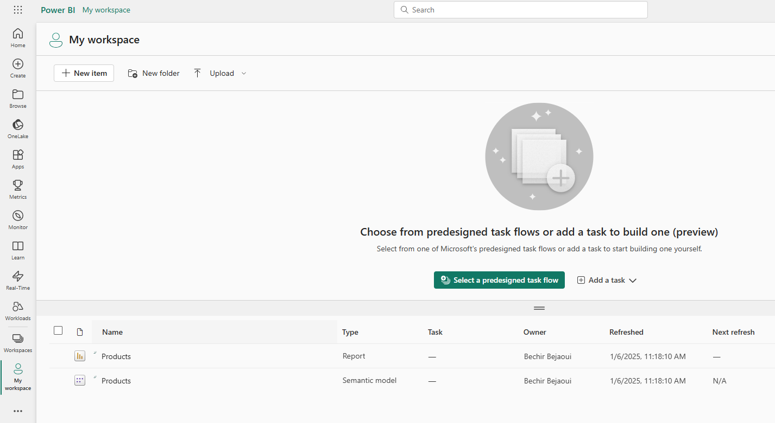
Deploy reports
Notice the presence of two files at the list level at the workspace level

Slide 6
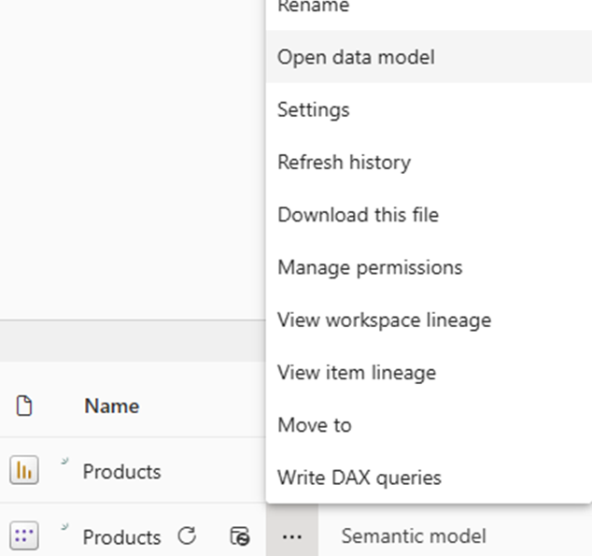
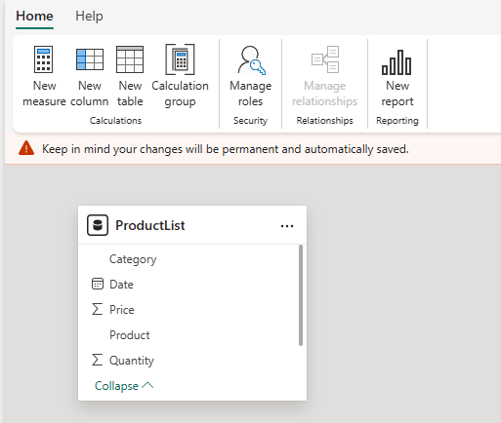
Deploy reports
The second Semantic Model file is the presentation of the data model that provides a structured, meaningful, and user-friendly abstraction layer for the data.

Slide 7
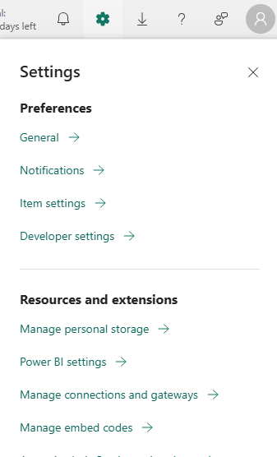
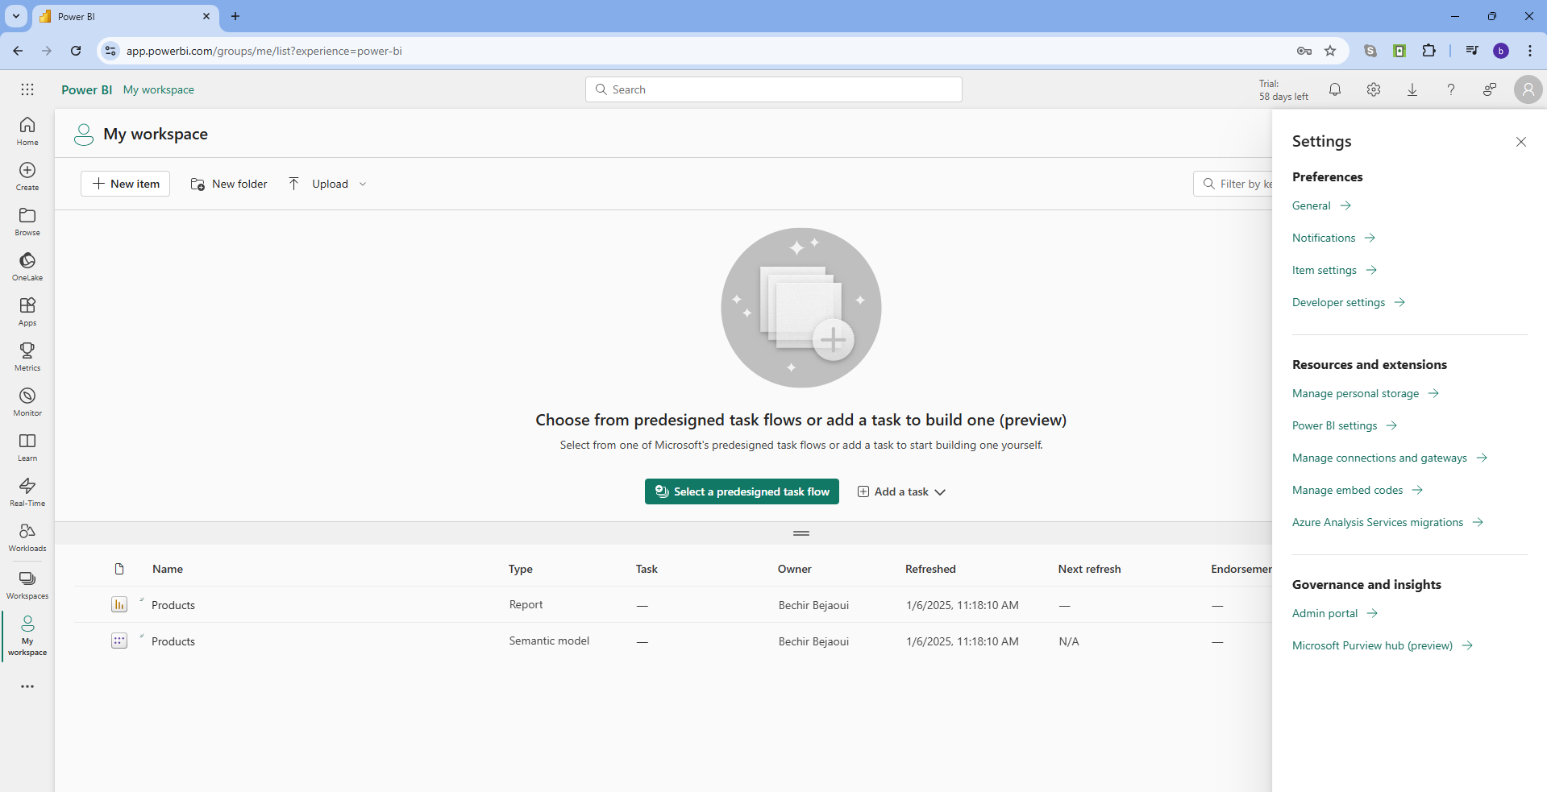
Deploy reports
Next, the gateway must be checked and configured correctly to ensure that data is refreshed when needed.
1
2

Slide 8
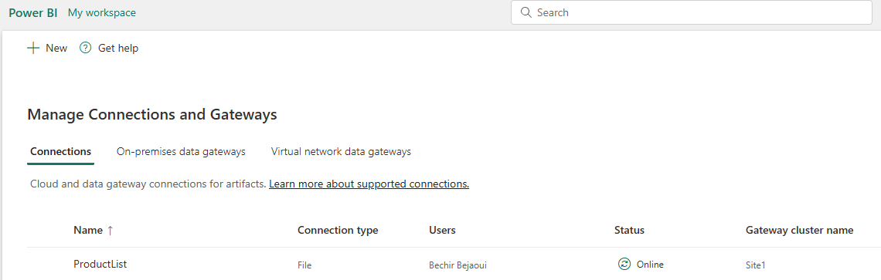
Deploy reports
We need to check if the connection is created and established with the local data source.

Slide 9

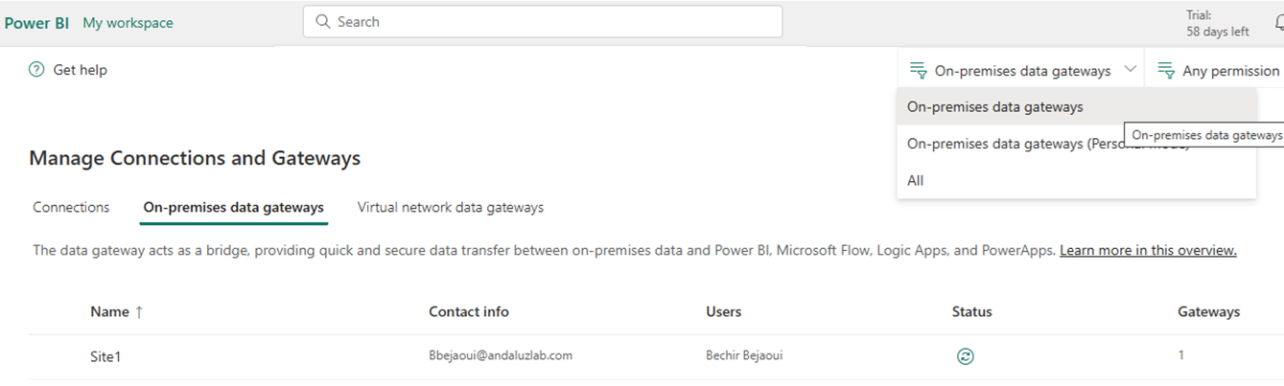

Deploy reports
Otherwise, we need to check the data gateway by clicking the button
We also need to check the connection status.

Slide 10
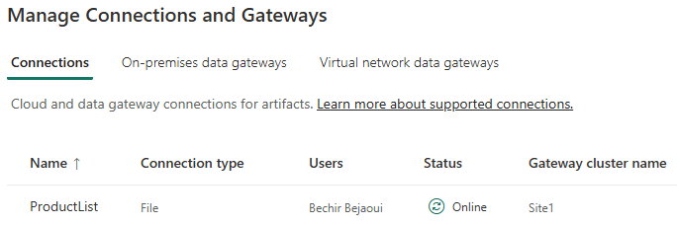
Deploy reports
We also need to check the connection status.

Slide 11
Deploy reports
If the connection settings change, it is possible to update or create a connection to the data source .
Note: A valid Windows username and password are required.
Note: The username must follow the pattern computername \user .

Slide 12
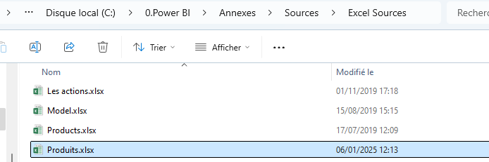
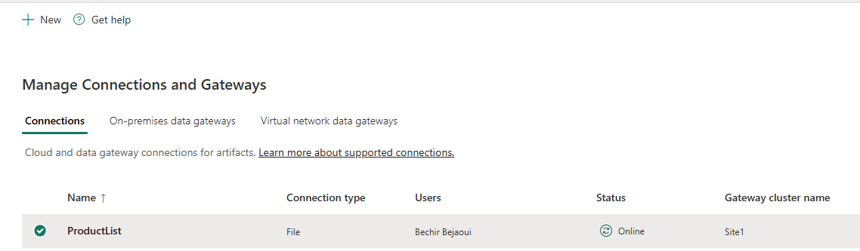
Deploy reports
We assume creating a new connection to the Excel file.
Select the Connections tab , and appears

Slide 13
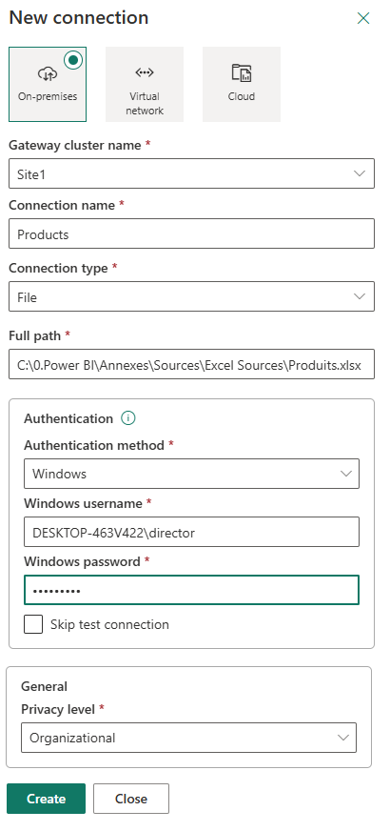
Deploy reports
Click the button .
1
The footbridge
6
The authentication method
7
The username
2
The name
8
The password
3
The login name
4
The connection type
9
The level of privacy
5
The path to the source

Slide 14
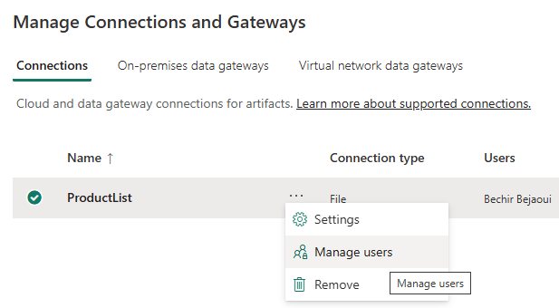
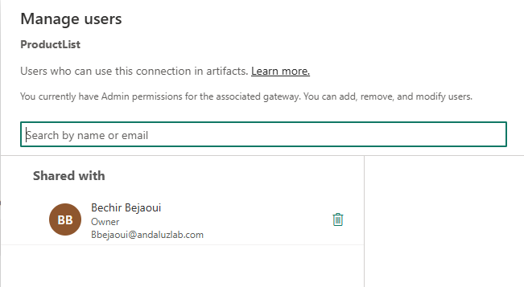
Deploy reports
It is possible to share this connecting to the data source with others members of
the workspace by searching for them by email and adding them .

Slide 15
THANKS
THANKS

